Slide 1


Problem Statement
To Design and Develop a Deep Learning algorithm to classify the video as deepfake or pristine.
DEEPFAKE DETECTOR USING ML

Slide 2














Tools and Technologies
Programming Languages
Python3
JavaScript
Programming Frameworks
PyTorch
Django
Programming Languages
Python3
JavaScript
Programming Frameworks
PyTorch
Django
Algorithms
ResNext – feature extraction
LSTM – Long Short Term Memory
Tools and Technologies
IDE
Google
Visual Studio Code
Cloud Storage
Google Drive
Algorithms
ResNext 50 & LSTM

Slide 3
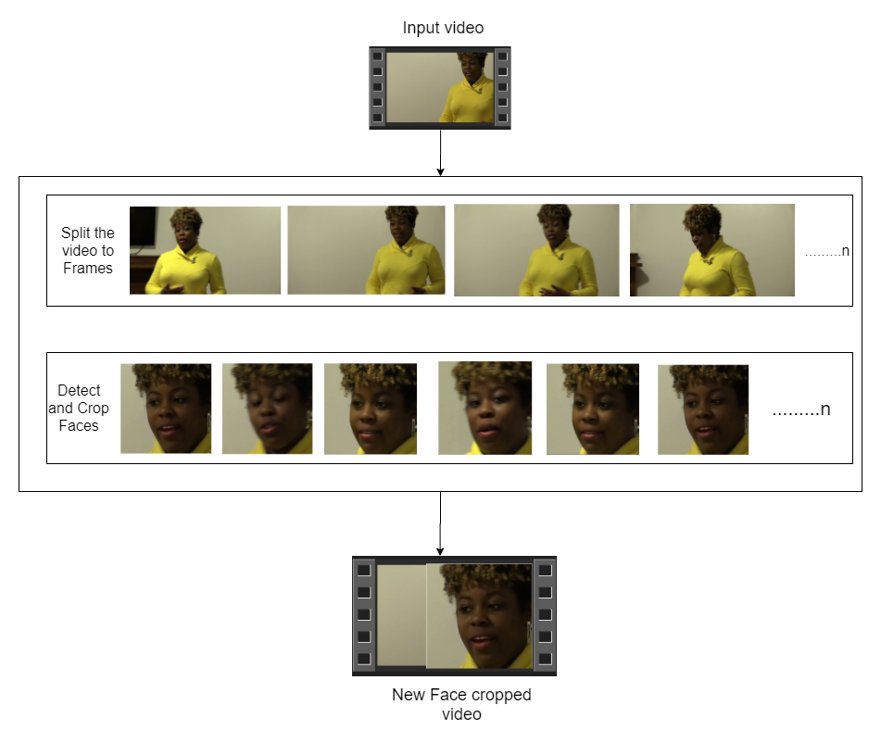

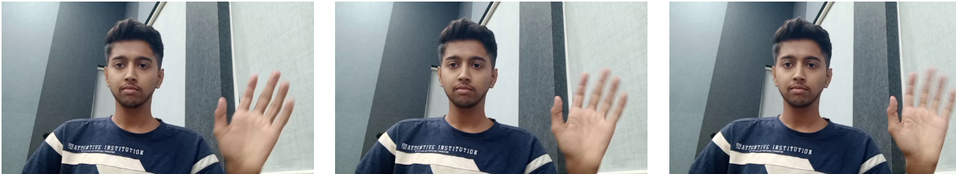
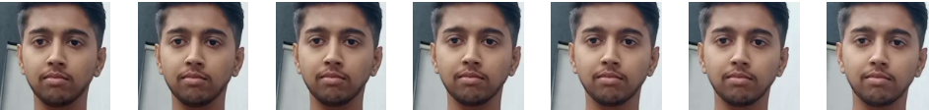
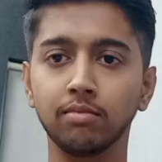

Pre-processing
SPLIT VIDEO INTO FRAMES
FACE DETECTION
5
4
3
2
1
CROPING FACE
CREATING NEW FACE CROPPED VIDEO
SAVING THE FACE CROPPED VIDEO

Slide 4
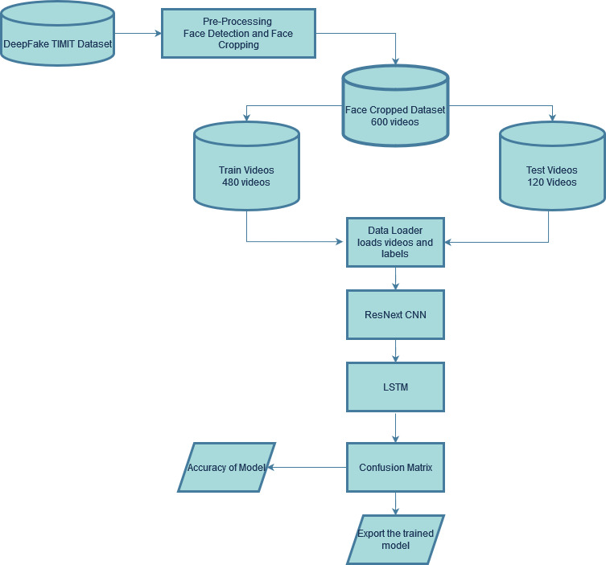
Training Workflow

Slide 5
Recommendations by Judges
User accessibility & feasibility
Live test demonstration
&
Model Creation

Slide 6
Limitations
01
Not supported to non-cuda devices
High GPU requirement
02
03
Video length &
frames limitation
Only face deepfake
detection
04

Slide 7
Future scope
Social media Integration
Cloud hosted accessible platform
Government Compliances
Multiple face & full body deepfake detection

Slide 8


Slide 9
THANK YOU

